Slide 1
HErAcles Hiring made easy
Murali Mohan
+91-87906-38406, murali_va@hotmail.com

Slide 2

Problem Statement
Hiring is a complex process where stakeholders constantly need to deal with tedious tasks in some of the following areas.
Sourcing
Scheduling
Reporting
Communication etc.
Vision: We aim to create an ecosystem that simplifies the hiring process by integrating automated solutions to disparate problems.

Slide 3


Slide 4
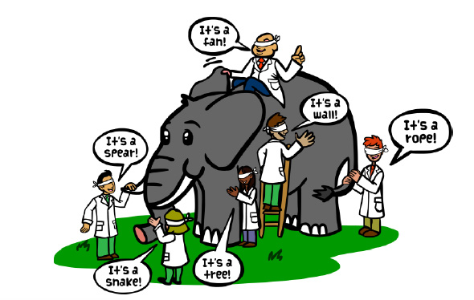
Market Opportunities (1/3)
Most software solutions in the market address only a subset of problems.
We aim at managing the full life cycle of the hiring process.
Assist in every step of the process.
Provide smooth end-to-end workflows.
Timely communication and reporting.

Slide 5

Market Opportunities (2/3)
Software solutions are either too basic or too complex to meet customer requirements.
Our solution is designed to be extensible to meet customer needs.
More convenient than spreadsheets because of workflows, notifications and reminders.
Simpler than large systems that are unwieldy for customization.

Slide 6

Market Opportunities (3/3)
Communication delays and unavailability of personnel slow down the hiring process.
We automate routine tasks to speed up execution.
Stakeholders are promptly notified of changes at every step.
Real-time reporting of the hiring status to management.

Slide 7

OUR SOLUTION

Slide 8
Full Life Cycle Management
We provide a one-stop solution to manage the full life cycle of hiring. Goals Include:
Assist in every phase of hiring (with suggestions and recommendations).
Provide smooth end-to-end workflows by connecting all the different phases.
Enable effortless communication and reporting to stakeholders through the hiring process.
1.Requisition
2.Sourcing
3.Shortlisting
4.Scheduling
Onboarding
Reporting
Communication

Slide 9



Value propositions
1
Savings in time reduce operating costs and improve the bottom line.
2
High degree of accuracy in finding the right candidates yielding higher ROI.
Real-time reporting enables better decision-making.
3

Slide 10
Scheduling
Scheduling: For shortlisted resumes, few solutions have capabilities to comprehensively and flexibly handle the hiring-process workflow from setting up the panel to creating interview rounds to releasing the offer.
Scheduling: A very large segment of recruiters and hiring managers follow manual processes and use basic tools like spreadsheets to carry out the hiring process.

Slide 11
Problem Statement
Recruitment is a complex and multifaceted problem. Our vision is to comprehensively address the issue and provide a one-stop solution by:
Bringing job-seekers and recruiters on to a common platform.
Use AI techniques to classify applicants’ resumes to match to opens positions and aid in the shortlisting process.
Automating the scheduling of interview rounds and predict the possibility of hiring after each round.
Objectively evaluating the candidate’s performance and systematically arriving at hiring decision, and
Enabling closer collaboration and providing comprehensive view of the hiring status to all the stakeholders.

Slide 12
Mission Statement (contd…)
Recruitment is a complex and multifaceted problem. Our vision is to comprehensively address the issue and provide a one-stop solution by:
Objectively evaluating the candidate’s performance and systematically arriving at hiring decision, and
Enabling closer collaboration and providing comprehensive view of the hiring status to all the stakeholders.

Slide 13
Market Opportunities (contd)
Poor or lack of communication exists between the stakeholders causing delays in the hiring process and impacting the bottom line overall.
Hiring decisions are ambiguous because of inconsistent feedback from the panelists.
History of the hiring process is not preserved and no comprehensive view of hiring status at different org levels.

Slide 14
Our Solution
Bring job seekers, recruiters and hiring teams on to a common platform.
Make the hiring process easy by (semi/)automating the scheduling of interview rounds between candidates and panelists.
Make hiring decisions objective, transparent and unambiguous by defining rules (ex: voting, rating or other custom rules) to the hiring procedure.

Slide 15
Our Solution (contd)
Provide a comprehensive view of the hiring status to hiring managers, recruiters and other stakeholders.
Enable instant and right level of communication among all the stakeholders during the hiring process.
Assist hiring teams to improve their procedures by proving an analytic view of their hiring processes.
Use AI to predict the relevance of the candidate to the job using some kind of pre-assessment(Test/Questionnaire/Past Experience etc).

Slide 16
Our Technology
Provide a cloud-based, multi-tenant solution to cater to the hiring needs of companies across business domains.
Notifications are a crucial part of our product to provide instant updates to stakeholders at various stages of the hiring process.
Web and mobile-based solution for ubiquitous availability, and fast and reliable communication.
Reporting tools to analyze the hiring processes and take course-corrective actions.

Slide 17
Target Customers
Businesses with continuous hiring needs.
Provide VAS to online portals like naukri.com, monster.com, shine.com etc.

Slide 18
Value Proposition
Streamlined hiring process for businesses to save time and/or outsourcing costs.
Automated web and mobile notifications help in reducing delays associated with communication between stakeholders.
Enables objective and fast decision-making and hence less time is required to bring an employee on board.
Provides a great value-added-service to online job portals that just hold the profile information of a job seeker.

Slide 19
Selling Strategy
For SMBs
Digital Marketing.
Self-help mechanism in registering and choosing pricing-plans.
For Large Enterprises
Custom onboarding and pricing plans.
For job portals
Custom onboarding and pricing plans.

Slide 20
Customer Acquisition
For SMBs
Digital Marketing & In-Person Marketing.
For Large Enterprises
In-Person Marketing.
For job portals
In-Person Marketing.

Slide 21
Management Team
Murali Mohan (Technology and Operations)
12 years of software development experience.
4 years of operations and delivery experience.
Product Owner TBD
Business Owner TBD

Slide 22
Revenue Model
Software will be provided as a Service. Customers subscribe to our service and pay per use.
Standard pricing plans.
Customized pricing plans.

Slide 23
Competition
BambooHR.com – Has good UI, but lacks the ability to clone interview process workflow and setting up interview evaluation criteria.
Zoho.com – Workflows are basic and cannot handle complex requirements.

Slide 24
Status(Technology)
Technical designs for backend software in progress
TBD:
Technical designs for frontend and mobile.
Implementation of designs.

Slide 25
***

